Slide 1

Value Chain Design and
BC Model Review –
Findings & Next Steps

Slide 2

Contents
Purpose & Outcomes
Findings and Analysis
Next Steps

Slide 3
Value Chain Design and BCP Work Plan
Purpose & Outcomes
  SMNYL is currently moving to a process work-approach to finally achieve a strong BCP Framework and a deeper Operational-risk culture
Approximative dates
2016
Phases
M1
M2
M3
M4
M5
M6
M7
M8
0. Value Chain Design and BCP review
a. Process Mapping
  b. Value Chain design
  c. BC Work-Calendar
Operational Risk Framework
  Process Documentation
  Identification of Risk & Controls
  Quantification
Business Continuity Plans
  BIA & RIA
  BCP Definition and testing
BAU
Project Scope

Slide 4



Value Chain Design and BCP Work Plan
Purpose & Outcomes
Purpose of the Phase
  To identify SMNYL’s current processes and design a Value Chain that let us develop a future Operational Risk Framework as well as analyze current Business Continuity Plans to detect possible weaknesses…
Facts & Outcomes…
The Value Chain, based on a end-to-end process approach has been defined, after interviewing 85 employees and 70 meetings (assessment and validation)
A two years Work Plan to implement the target Business Continuity Plan Model has been designed as a result of the diagnostic assessment of the SMNYL’s BCP made by a group of specialists through Work Shops with SMNYL employees
Key tactical Operational Risk and Controls and key Business Continuity Risks have identified and documented

Slide 5
Contents
Purpose & Outcomes
Findings and Analysis
Next Steps

Slide 6


Value Chain Design and BCP Work Plan
Findings and Analysis
Findings and Analysis
  As a result of meetings maintained with users, we have obtained a number of conclusions regarding the process execution and current Business Continuity Plans, that are summarize below…
Process Execution
& Operational Risk
Business
Continuity Plans
  Some users have documented their procedures and politics, but these documents do not follow a standard and are developed under the previous work-approach
  Many areas have identified their critical Business Continuity processes. However, not all functions are defined, the majority of BCPs have never been challenged and are not standard
  There are some functions, as Quality areas, that has permitted to implement controls to mitigate risks.. Nonetheless not all risks and controls are documented and not all risks have been detected
  Critical risks and BCPs are defined considering the relevance of unavailability of systems. It’s necessary to include other dimensions (employees, suppliers, property)
  Processes are carried out by a large number of areas, what usually implies an increase on operational risk
  Need to establish a BCP proper Governance, identifying the components off each Line of Defense (1st, 2nd & 3rd)
  It is necessary to review the current Operational Risk Management (ORM) Model to align it to the new process approach
  Guidelines for crisis communication as well as roles and responsibilities need to be reviewed, especially in communications to customers, suppliers & authorities
  The is an opportunity to carry out Transformation Plans to mitigate certain weaknesses from the organizational, efficiency and technological standpoint

Slide 7
Contents
Purpose & Outcomes
Findings and Analysis
Next Steps

Slide 8

Value Chain Design and BCP Work Plan
Next Steps
Next
Steps
Based on the conclusions obtained, it has been identified three
Work Streams that will lead SMNYL to obtain a helpful Operational Risk Framework and a reliable Business Continuity Model…
1
Review and Execution of the Operational Risk Management Framework
To construct a comprehensive ORM Framework it is necessary to first define how to implement the Model; reviewing methodologies, designing the Governance and Organizational Model... Once this is accomplished next step is to implement it
2
Strengthening of current Business Continuity Plan
The work plan is designed to complement the existing methodological framework on priority processes, defining the management framework and Government of the model , taking full advantage of the elements developed by SMNYL
3
Integration of Developed Frameworks in BAU (Business As Usual)
In order to conduct a proper implementation it is necessary to have a system which will cover all aspects of operational risk management ..
Now, it is important to organize work-teams to carry out these three Work-Streams and to calendar Kick-Offs to start as soon as possible, previous approval

Slide 9
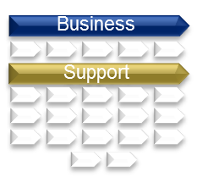
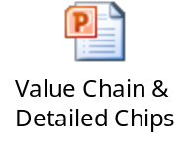
Value Chain Design and BCP Work Plan
Purpose & Outcomes – Value Chain
Value
Chain
  Designed Value Chain is comprised of 104 processes and split into two major groups; business and support processes …
About de Value Chain…
.. it is comprised of 5 business macro-processes divided into 34 processes..
.. while support macro-processes amount to 17 and formed by 70 processes..
.. on average there are 4 participants areas per process, especially in Business Processes..
Chips have been developed to detail the scope, main activities and participants of each process
Example
Process Description
Participants
The insured deposits at “Counter” all the necessary documentation to receive authorization for a scheduled medical intervention . It is digitized , generating a
folio in Webflow validating the request by “Operations”.
In the case of large brokers, the request is received via mail , opening
a folio from the area of ​​Compensation GMM - Broker.
“Dictamen” area determines whether it is appropriate or not
generating a letter is automatically sent to the customer. .
“Counter”
Operations
Underwriting
Operations Quality
Compensations
GMM – Broker
See detailed Chips
PN – GS - 03
Programmed
Events
Back

Slide 10

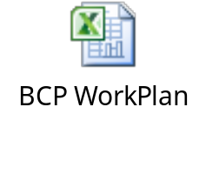
Value Chain Design and BCP Work Plan
Purpose & Outcomes – BC Plan
Business Continuity - Work Plan
  The status of current Business Continuity Plans has been raised after interviewing the responsible of Business Continuity Plans of each area…
  Two Workshops interviewing more than 15 people…
  As the head of the BC Committee, a specific interview was held with IT Dept ..
  Documents related to Business Continuity Plans were analyzed by the team ..
  Resulting the following Roadmap..
2016
2017
1st Semester
2nd Semester
1st Semester
2nd Semester
Business Continuity
Model - Work Plan
See detailed Plan
Management &
Governance
Priority Processes
Non-Priority Processes
  Work-Streams
Strategy and Methodological Frame
Priority Processes
Non-Priority Processes
Business
Continuity Plans
Back

Slide 11
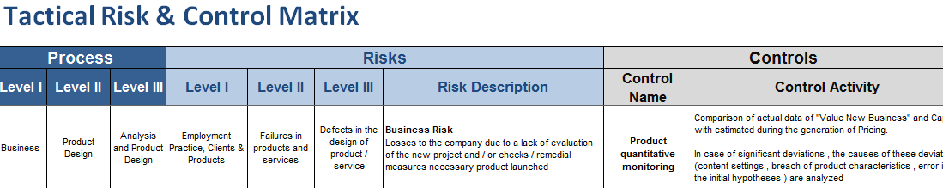
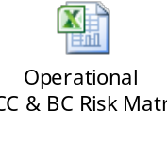
Value Chain Design and BCP Work Plan
Purpose & Outcomes – Risk Matrixes
Operational & Business Cont. Risk Matrixes
  Based on our experience in the insurance sector, the team has developed an Operational Risk Matrix composed by approximately 60 risks and controls, and identified different scenarios that threats business continuity…
Risks are described and classified under a market-practice taxonomy
Tactical Risks & Controls Matrix
Proposed risks are linked to the processes of the designed Value Chain
Description of the
control that mitigates risk
Structured as follows..
See detailed Matrixes
  Three groups of possible threats…
  Having an impact on…
Business Continuity Risks
    Natural disasters
    Accidents
    Deliberate Actions
    Employees
    Infrastructure
    Services
    Technology
Back

Slide 12

Value Chain Design and BCP Work Plan
Findings and Analysis – Organizational Weaknesses
  It has been identified some possible improvements from an organizational, technological and efficiency point of view…
Process Weaknesses…
During the Value Chain design, weaknesses in processes have been detected, some of these are..
  Organizational
    Communications to customers and sales force do not necessary meet guidelines.. (i.e.: From Operations, there are communications that haven’t been reviewed by the owner of “Communications to customer” process)
    The collection of certain types of products do not follow the standard (i.e.: wage discount policies followed a process different to others)
    Cash-Flow “Contracts” with some customers
  Process inefficiency
    In some processes there is an excessive degree of segregation, what implies an increase in the time to execute them (i.e. Technical review of products)
    Some processes are carried out by different areas depending on some parameters. The path carried out by the different areas do not follow a standard (i.e.: Property Management; Human Resources or Investment )
  Technological
    Some systems lack certain functionality, what makes necessary to register the information not only in several systems (MedNext, Segu-Compra, Excel sheets)
Back

Slide 13
Value Chain Design and BCP Work Plan
Next Steps – Review and Execution of the ORM Framework (1/4)
1
Review and Execution of the Operational Risk Management Framework
To construct a proper ORM Framework it is necessary to first define how to implement the Model; reviewing methodologies, designing the Governance and Organizational Model... Once this is accomplished next step is to execute it (process documentation..
To construct an appropriate ORM Framework it should be considered next four dimensions..
Governance, Organizational and Functional Model
Methodologies:
Integration in Management
Technological Support
Quantitative
Qualitative
Integration of methodologies
Reviewing of the relationship between areas, functions of validation, the role of senior management, etc. and all aspects relating to the existence of an adequate ORM
Role of Internal Audit in the review of methodologies and system of ORM.
Review of Risk Taxonomy and Self Assessment Methods (evaluation questionnaires and scenario analysis)
Review of the variables considered to evaluate (frequency, average impact, worst case scenario, etc.) and quantification procedure
Definition of risk appetite
Review of reports and analysis of sufficiency and adequacy of information..
Definition of Risk Mitigation Plans
measures and monitoring
Operational Risk System definition; coverages requirements, robustness, integrity and data quality
Automatization of…
Report Generation
Capital Calculation
Etc..

Slide 14

Value Chain Design and BCP Work Plan
Next Steps – Review and Execution of the ORM Framework (2/4)
1
Review and Execution of the Operational Risk Management Framework
To construct a proper ORM Framework it is necessary to first define how to implement the Model; reviewing methodologies, designing the Governance and Organizational Model... Once this is accomplished next step is to execute it (process documentation..
Once the framework is designed, next four steps should be carried out to execute the ORM Framework…
1
2
3
4
Operational Risk Management
Framework
Process Documentation
Risk and Control Identification
Risk and Control Valuation
Reporting and Analysis of results
Meetings with users are held in order to identify and document the way the process is carry out at that moment
Process improvements should be identified
Identification of risks and operational controls of the processes
Establishing KPIs & KRIs
Plans to improve controls
Creation and completion of self-assessment questionnaires for each process: economic impact , probability of occurrence, effectiveness of controls and indicators.
Generation of reports and analysis of results

Slide 15
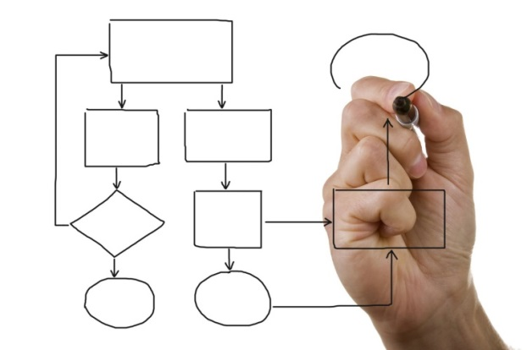
Value Chain Design and BCP Work Plan
Next Steps – Review and Execution of the ORM Framework (3/4)
1
Review and Execution of the Operational Risk Management Framework
To construct a proper ORM Framework it is necessary to first define how to implement the Model; reviewing methodologies, designing the Governance and Organizational Model... Once this is accomplished next step is to execute it (process documentation..
How to carry out the execution…?
Process Prioritization
Based on the Value Chain designed, a group of 30-40 processes should be selected to be documented first.
Based on our experience and findings during the project, 36 processes have been selected by the team as priorities
End-to-end Pilot Proof
To execute previously mentioned four steps in two processes from the prioritized group. The reason to do this is to detect weaknesses from proposed methodologies, weaknesses in the governance, training needs..
“Programmed Event” and “Provision Calculation” have been chosen to carried out the pilot proof
Global Implementation
After pilots it should be carried out the documentation, risk and control identification and quantification of the other processes classified as priority
Back

Slide 16
Value Chain Design and BCP Work Plan
Next Steps – Review and Execution of the ORM Framework (4/4)
Prioritization analysis results in 18 business processes and 18 support ones..
  Product Analysis and Design
  Pricing
  Sales Force and Agencies Contract
  Additional Compensation to Sales Force
  Sales Force and Agencies Termination and Modification
  Quoting and Underwriting – Individual
  Quoting and Underwriting – Groups
  Quoting and Underwriting – Telemarketing
  Quoting and Underwriting – Bank-assurance*
  Collection – Individual
  Collection – Groups
  Collection – Wage Discount Policies
  Cancellation of Policies
  Complaints
  Medical Partners Management
  Fund Management
  Life Payments Claims
  Programmed Events
Business
Processes
18
  19. Suppliers Selection & Hiring
  20. Property Management
  21. Assets Sell/Buy
  22. Assets Value Update
  23. ALM
  24. Credit Analysis
  25. Budget Generation & Monitor
  26. Treasury Management
  27. Intelligence & Competitive Analysis
  28. Financial Statements Generation
  29. Taxes
  30. Provision Calculation – Individual
  31. Provision Calculation – Groups
  32. VNB Estimation
  33. EV and Fair Value Estimation
  34. Customer Communications
  35. File and Documentation Management
  36. TI Services and Incident Management
Support
Processes
18
Prioritization Methodology…
Degree of exposure to Operational Risk → Based on MS knowledge about Risk distribution and consumed VaR
Possibility to Transform → Significant weaknesses were detected in some processes and considered to prioritize them
Back

Slide 17
Value Chain Design and BCP Work Plan
Next Steps – Strengthening of current Business Continuity Plan (1/3)
2
Strengthening of current Business Continuity Plans
The work plan is designed to complement the existing methodological framework on priority processes, defining the management framework and Government of the model, taking full advantage of the elements developed by SMNYL
1
Governance & Management Framework
Review roles and responsibilities of management model BC - organizationally and government
Formalize the framework of business continuity management policy
2
Transform the current criteria and methodology to a “process approach”
Meetings with the process owners for the survey of critical resources for its implementation
Assessment and impact analysis disruption (BIA) and risk assessment (RIA)
Definition of BIAs & RIAs
3
Defining recovery times and service levels
Definition and formalization of business continuity strategies by type of disruption
Design of the model of contingency communication and training
Continuity Strategies
4
BCP development
& testing
Define action plans for process / disruption type; documentation and formalization of BCPs
Test to model and obtain feedback
Prior to deployment, it is proposed to define the objectives and scope BCP based on a prioritization process
As proposed before, it should be recommendable to choose 1 or 2 critical process from the Business Continuity approach and to develop an end-to-end Pilot Proof..
Back

Slide 18
Value Chain Design and BCP Work Plan
Next Steps – Strengthening of current Business Continuity Plan (2/3)
2
Strengthening of current Business Continuity Plans
The work plan is designed to complement the existing methodological framework on priority processes, defining the management framework and Government of the model, taking full advantage of the elements developed by SMNYL
As shown previously, the roadmap designed by the team to improve current BC Plans is a two year task-calendar …
2016
2017
1st Semester
2nd Semester
1st Semester
2nd Semester
Business Continuity
Model - Work Plan
Management &
Governance Framework
Priority Processes
Non-Priority Processes
Definition of BIAs
& RIAs
  Work-Streams
Priority Processes
Non-Priority Processes
Continuity
Strategies
BCP development
& testing
Priority Processes
Non-Priority Processes
Once the methodology and Governance are approved, it should be carried out the end-to-end pilot proof. It is estimated to be accomplished in the first 4-5 months
Back

Slide 19

Value Chain Design and BCP Work Plan
Next Steps – Strengthening of current Business Continuity Plan (3/3)
Based on the impact to customers, in continuity of daily work, noncompliance with regulators… next processes have been selected as priorities…
Business
Processes
Support
Processes
✓
  Collection – Individual
  Collection – Groups
  Collection – Wage Discount Policies
  Premiums refunds
  Cancellation of Policies
  Complaints
  Fund Management
  Life Payments Claims
  Hospitalization
  International Claims
✓
  Suppliers Payment
  Assets Sell/Buy
  Assets Value Update
  Treasury Management
  Financial Statements Generation
  Regulatory Reporting
  Accounting & Statistic data generation
  Taxes
  Issues from Authorities
  Customer Communications
  Security and TI Operative Support
  Corporative Security
  TI Services and Incident Management
✓
✓
✓
✓
✓
✓
✓
✓
✓
✓
✓
✓
✓
✓
Processes selected as critical in the improving
of the Business Continuity Model
Back

Slide 20

Value Chain Design and BCP Work Plan
Next Steps – Integration of Developed Frameworks in BAU (1/1)
3
Integration in a
Business As Usual
Once the Framework is implemented, it is necessary to have a system (software) that permits to work with all the documentation and information raised. This system should cover the following dimensions..
Integrated Vision
Controls
Management
Documentation of controls: frequency, responsible, output, etc.
Linking direct risk controls
Individual evaluation of controls
Different visions: organizational, by area, by processes
Multi-entity, multi-currency, multi language
KRI Management & Alarms
KRIs registration and documentation (description, type, responsible, etc.)
Customizable management levels
Flexibility in the management of processes at different levels (corporate and local)
Process documentation
Access through multiple filters to process information
Processes Management
Executive and Audit Vision
Executive reports and dashboards for senior management
Several profiles (auditor, etc.)
Risk assessment questionnaires: medium impact (inherent and residual), frequency (and worst case scenario
Getting metrics: expected loss and VaR
Link, if available, to Events Database.
Risks
Management
Reporting
Customization and report definition as in the implementation of the system
Traceability (historical photos)
Back

